Slide 1
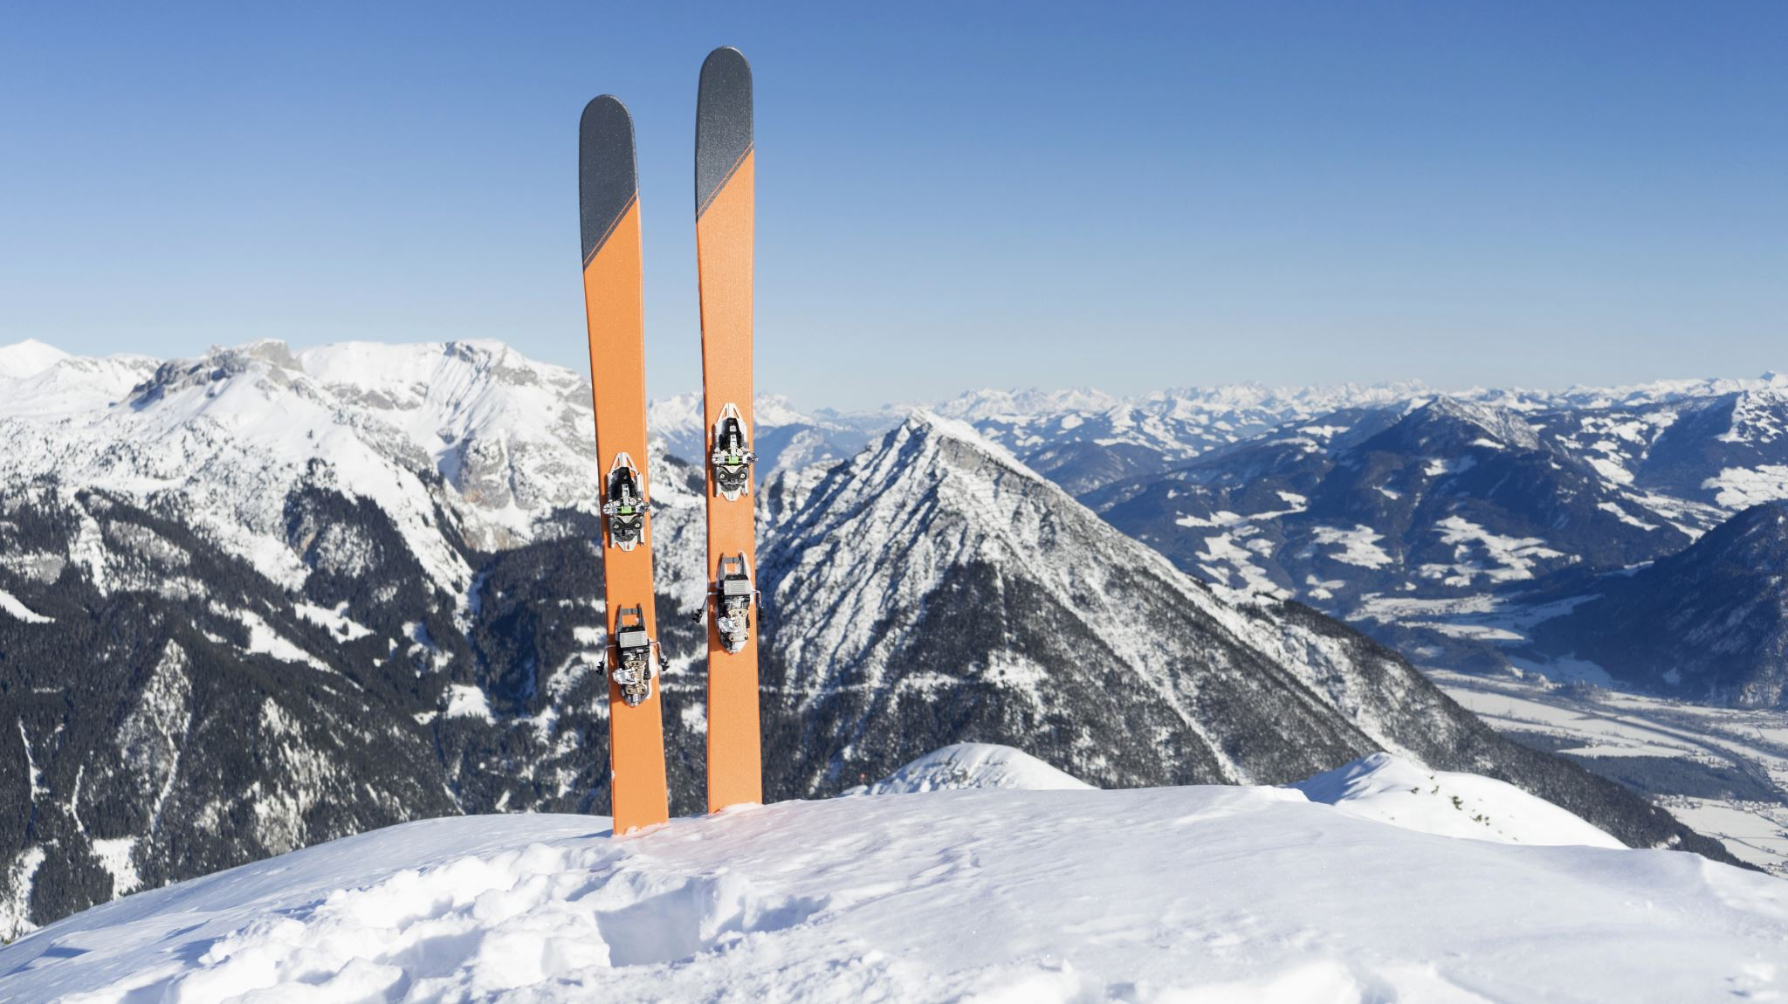
Snow Top Ski Area of the Green Mountains in Vermont, the USA,
PPT about different sceneries impact on its profit margin
By Maksat Mametjumayev

Slide 2
Introduction -There are economic and climate change factors that play main impact role in all three different sceneries
Economic Factor Scenarios | 2020 | 2021 | 2022
Optimistic | 1% | 1% | 1%
Neutral | 0% | 0% | 0%
Pessimistic | -2% | -2% | -2%
Climate Change Scenarios | 2020 | 2021 | 2022
Optimistic | 0% | 0% | -3%
Neutral | -2% | -2% | -6%
Pessimistic | -3% | -3% | -3%

Slide 3
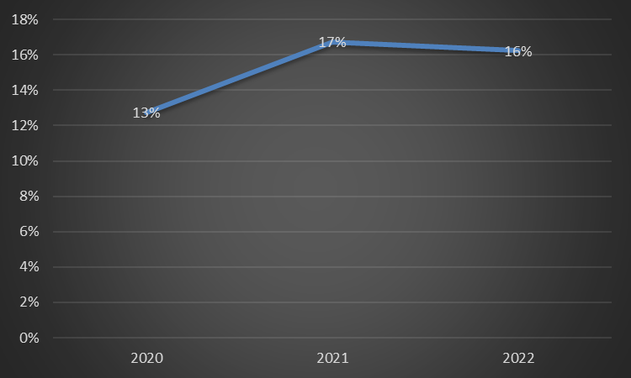
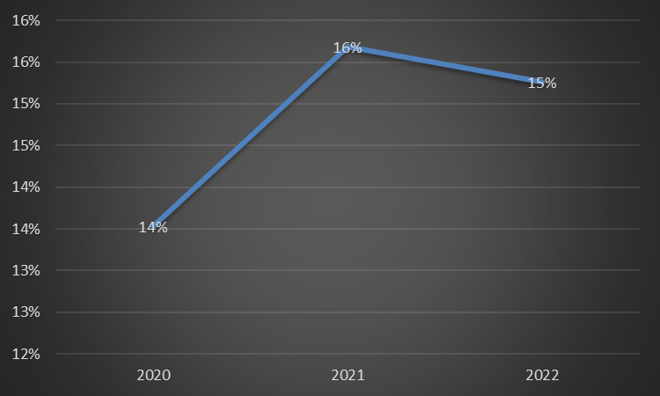
Optimistic scenario
With Summer Season
Without Summer Season

Slide 4
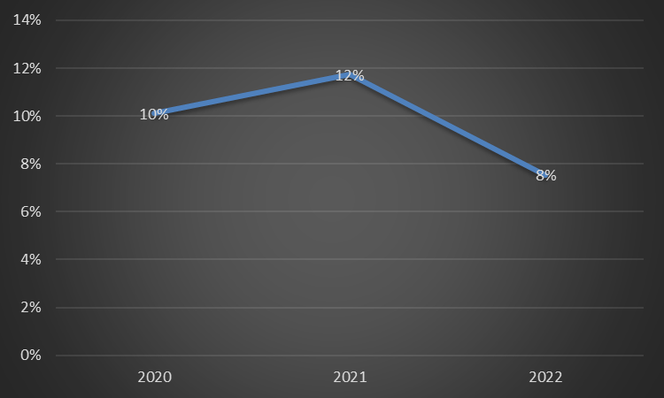
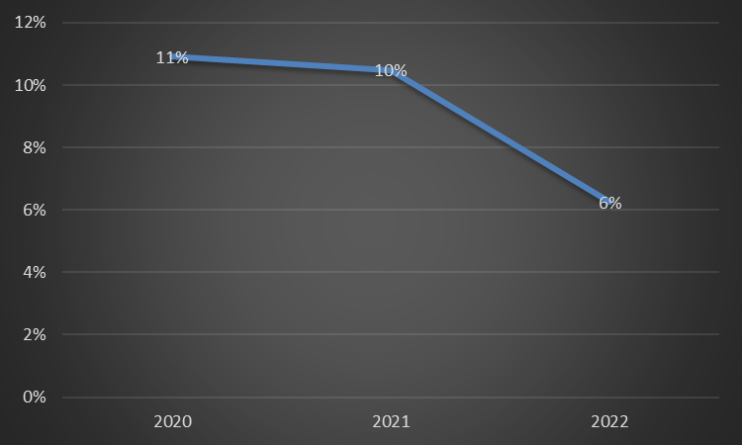
Neutral scenario
With Summer Season
Without Summer Season

Slide 5
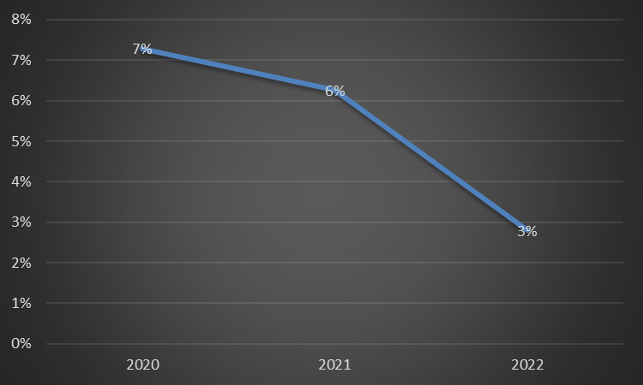
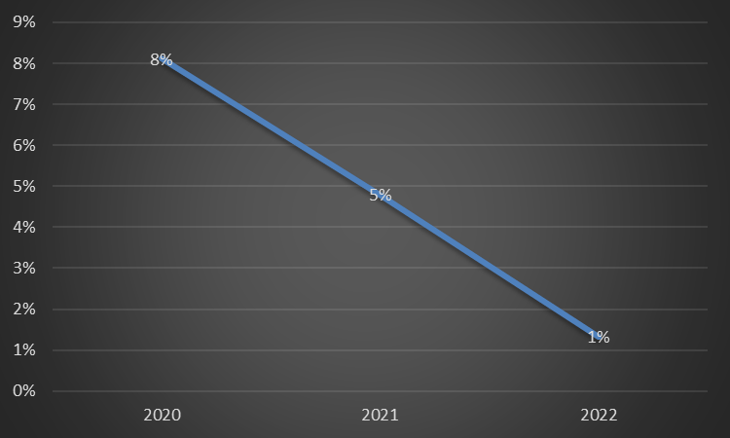
Pessimistic scenario
With Summer Season
Without Summer Season

Slide 6
Recommendation
Following Optimistic scenario as it has the highest positive profit margin.
1
Adding summer season because it increases the revenue.
2

